Slide 1
ELEMENTARY STATISTICS, BLUMAN
Normal Distribution Example 2
© 2019 McGraw-Hill Education. All rights reserved. Authorized only for instructor use in the classroom. No reproduction or further distribution permitted without the prior written consent of McGraw-Hill Education.

Slide 2
Objectives for this PowerPoint
How to use the standard normal distribution to find a probability associated with a normally distributed random variable.

Slide 3

Problem
The Bureau of Labor Statistics reported in 2016 that the mean hourly wage for registered nurses in the US was $34.70. Assume that nursing salaries are normally distributed with a standard deviation of $11.58. If a registered nurse is selected at random, what is the probability that he or she has an hourly wage that exceeds $54.62?
In probability notation, we would state this as the following:
P(x > 54.62)
Find the z score.
$$z=\frac{x−μ}{σ}=\frac{54.62−34.70}{11.58}=1.72$$

Slide 4
Finding the Probability
Finding the probability that the random variable x would exceed 54.62 would then be the same as finding the probability that a z score on the standard normal distribution would be greater than 1.72.

Slide 5
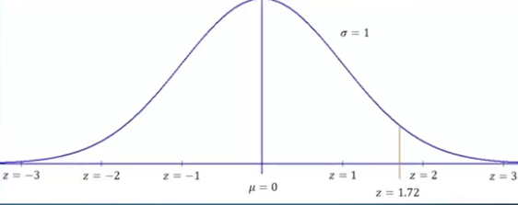
Graph of z Score
The z score 1.72 would lie between the z scores of 1 and 2 on our normal probability distribution a little closer to 2.

Slide 6
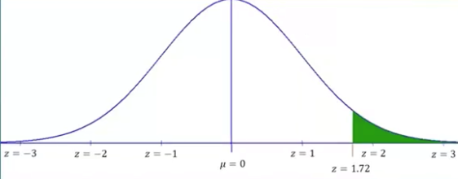
Graph with z Score
We are looking for the probability that z would exceed this value. Which would correspond to the area under the curve in this tail.

Slide 7
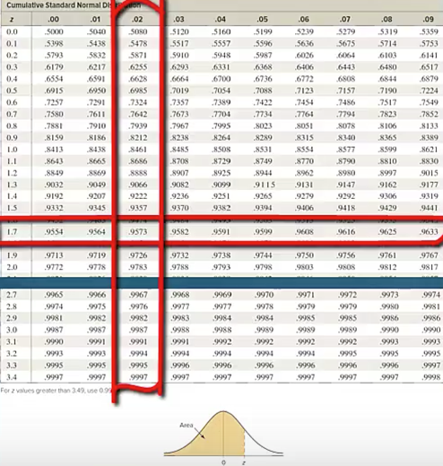
Cumulative Normal Distribution Table
Looking at the left column of the cumulative normal distribution table, we travel down until we find a z score of 1.7 and then travel to the right until we find where that row crosses up with the column that is headed .02. Here we find a value of 0.9573.

Slide 8

Cumulative Normal Distribution Probabability
We see at the bottom of this table the picture of the normal distribution. The four decimal place values in the body of the table correspond to the shaded region in the picture of the normal distribution.
The cumulative normal distribution probability associated with the z score of 1.72 would be .9573.

Slide 9
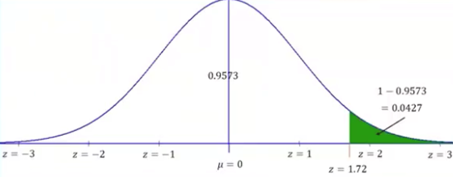
Subtract From 1
We were to find the probability that z would exceed that value which would then be the area under the curve on the other side of z equals 1.72. In order to find that we would need to subtract that value .9573 from 1 the total area under the curve.
P(z > 1.72) = 1 – 0.9573
P(z > 1.72) = 0.0427

Slide 10
Conclusion
The probability that z would exceed 1.72 would be equal to 0.0427.
Another way to state that result is assuming that nursing salaries are normally distributed with a mean of $34.70 and a standard deviation of $11.58, 4.27% would earn more than $54.62 per hour.

Slide 11
Summary
In this PowerPoint we learned how to use the standard normal distribution to find a probability associated with a normally distributed random variable.

